Slide 1
Fertility Rates Overview
Group 09 – Yongyeon Jang, Alessandro Seghini
Date: June 2025

Slide 2
Project Goal
Analyze how fertility rates have changed across countries in a restricted period :
- 1980 to 2023
Identify correlations between fertility rates and:
GDP (Country wealth)
Gini Index (Income inequality)
Growth rate (Population change due to births, deaths, and others)
Life expectancy at birth
Infant mortality rate (Age of 5 per 1000 lives)
Population

Slide 3
Data Sources
Data Joined Using: SQL (by country and year)
Sources:
U.S. Census Bureau – International Database (IDB): Population, growth rate, life expectancy at birth, mortality rate
Our World in Data – Fertility rates: Fertility rates
To have a better analysis (lower number of missing values)
Since the dataset is provided by the same company as below
Our World in Data – GDP: Gross domestic product – In constant US$
Our World in Data – GINI: Income inequality

Slide 4
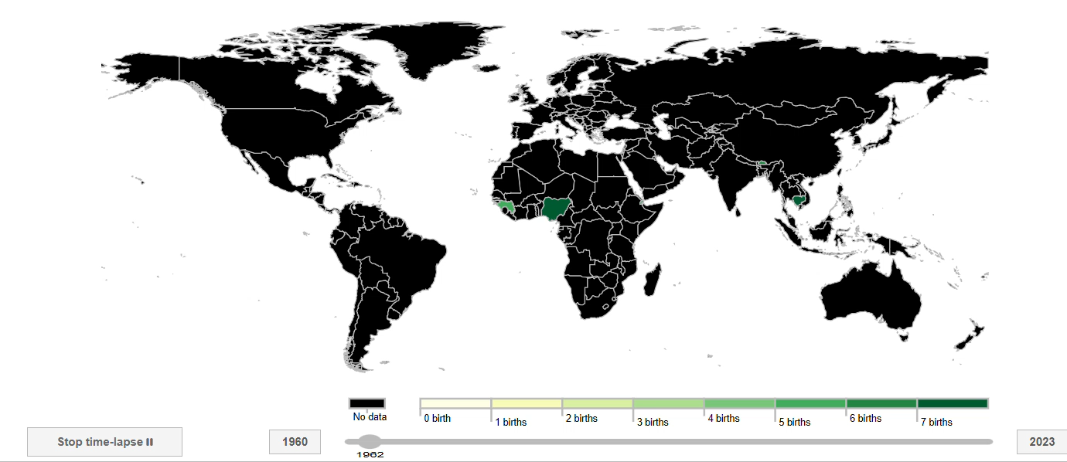
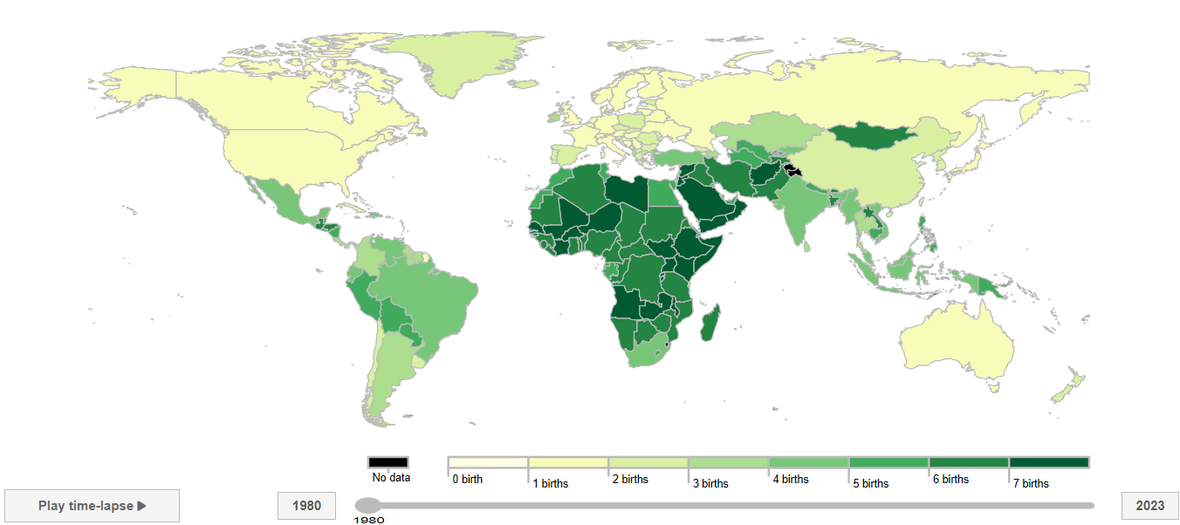
Dataset Sources Change
From
To

Slide 5
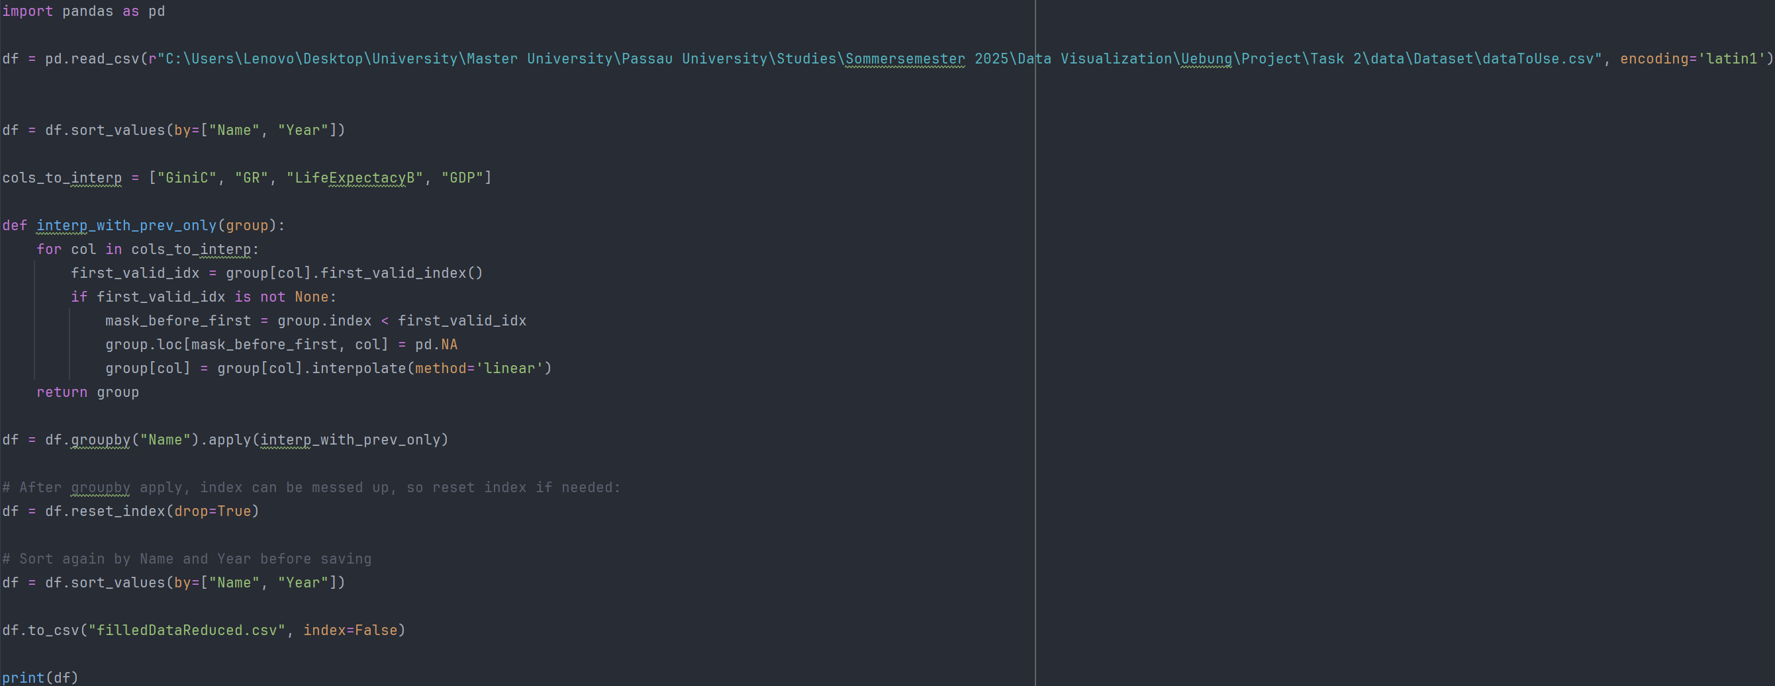
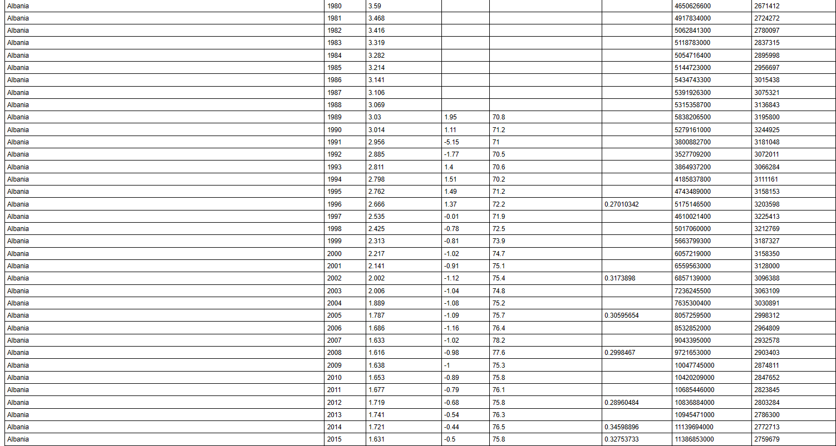
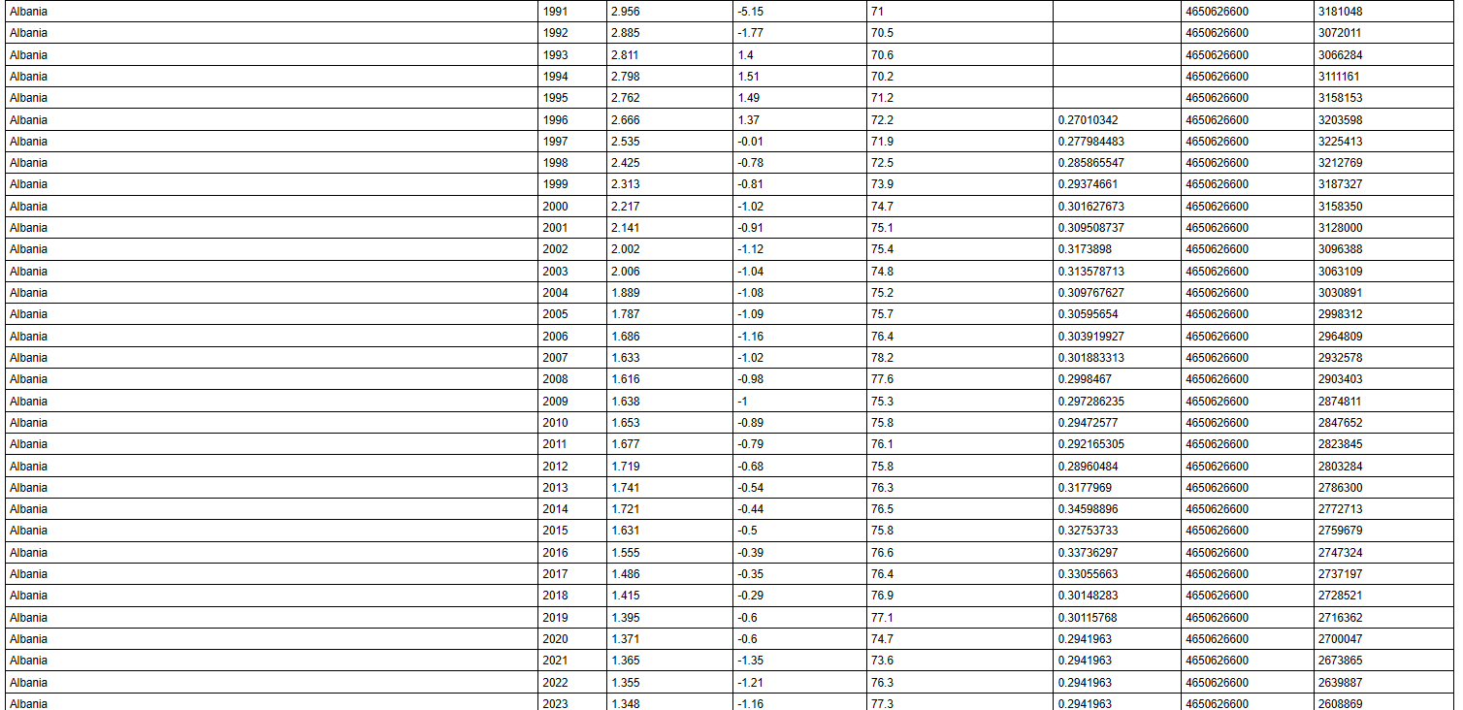
Data Interpolation

Slide 6
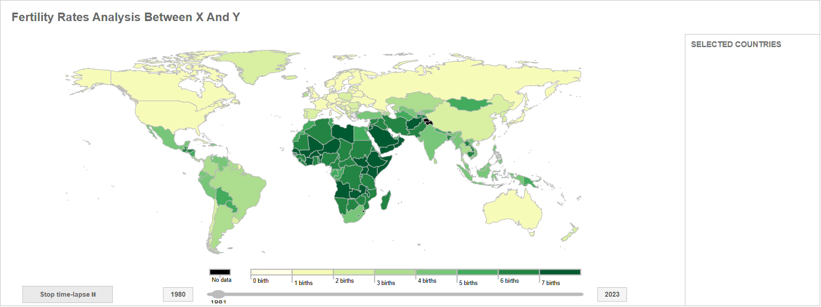
Chart 1 – Interactive World Map
Comprehend:
World map
Automatic timeline
Interactive fertility legend
Enables:
Country selection
Responsible:
Syncing
Time handling

Slide 7
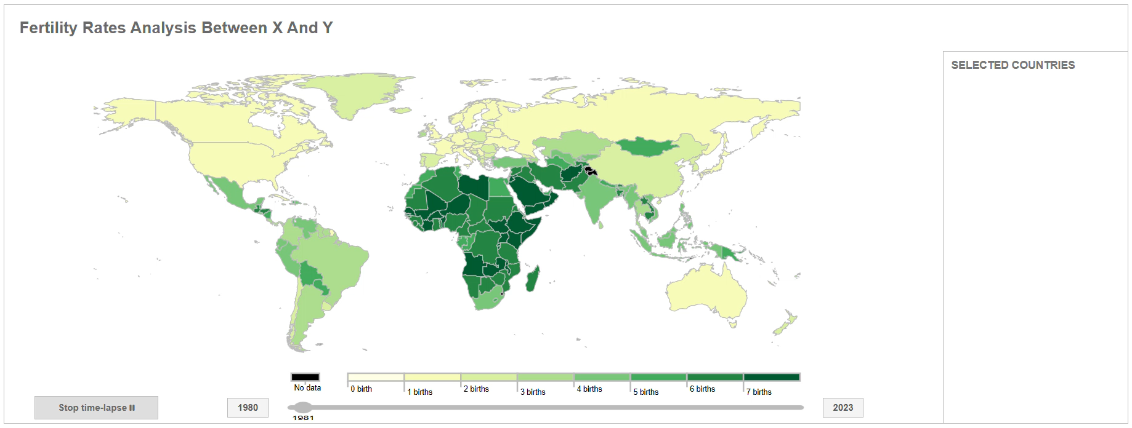
Chart 2 – Line Chart
Functionality:
Tracks fertility rate
Tracks population
Responsible:
Comparison

Slide 8
Chart 3 – GDP vs GINI Scatter Plot
Description:
- Triggered by selected countries on Chart 1
- Shows GDP vs GINI relationship
- Highlights fertility patterns by economic context
TODO

Slide 9
Chart 4 – Multi-Factor Visualization
Visual Variables:
- X-axis: Fertility rate
- Y-axis: Preset options (e.g., Child Mortality)
- Circle size: Third variable (e.g., GDP)
- Color: Geographic region
- Year selection via timeline
TODO

Slide 10
Summary
Overall Insights Toolset:
- Dynamic, comparative, and temporal data exploration
- Understand how socio-economic factors influence fertility trends
- Supports cross-country and time-based analysis
TODO

